Slide 1
CT Project Weekly Status Report
Jack Xu, Jenny Jiang Jun 19, 2020

Slide 2
Plan for this week
Try utilizing Google/Apple API and Huawei Contact Shield
Keep implementing code
Create use cases and scenario designs
Finish UI/UX designs
Our work this week
+ Analyze Germany’s approach and their paper
+ Analyze Google’s code on GitHub for server side.
- Keep implementing code
Decided to base this application on CS kit on Wednesday. Thus, functions we implemented on the first half of the week is no longer necessary.
We get the permission from HQ this Thursday. we will keep working on code next week.
+ Created document with detailed use cases and scenarios
+ Created use case diagram
- Finished UIUX prototype

Slide 3
Our work this week(Detail 1)
Research
Germany’s team’s work
Their approach of generating and verifying tokens
Germany’s paper on potential problems of Google/Apple API
Profiling and possibly de-anonymizing infected persons
Relay-based wormhole attacks that principally can generate fake contacts
Google code on GitHub
Google team uses Go to implement the server side. Takes time to learn
Huawei CS kit
Check all the documents and APIs
Made the documents of how to use this Kit
Implementation
Succeed in using Huawei CS kit
We can start to engine and get information needed from this API
Failed in using Google/Apple API
It requires to be in the whitelist

Slide 4
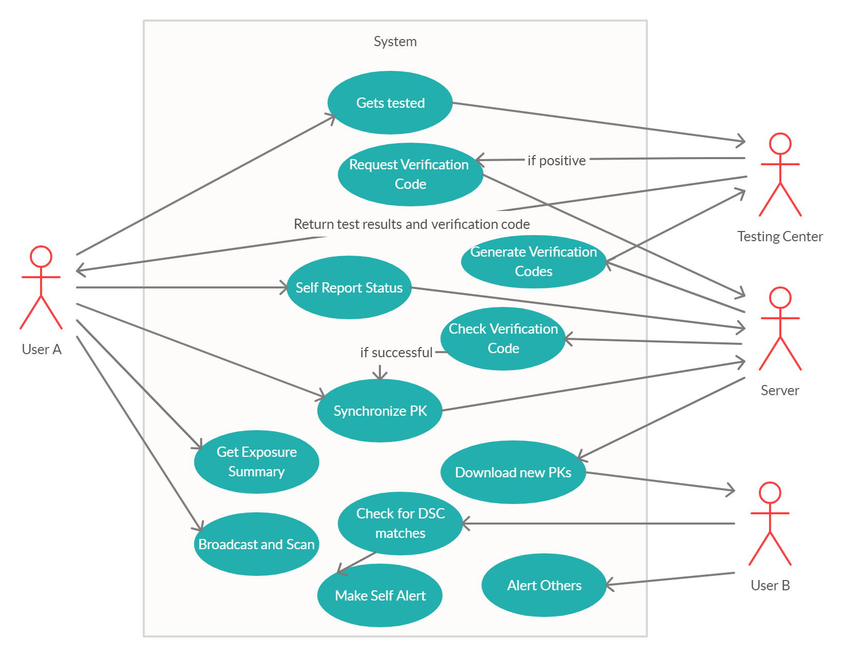
Our work this week(Detail 2)
Use Case Diagram and Scenarios
UI/UX Prototype Demo

Slide 5
Plans for next week
Learn Google functions and work on the server side
Implement a demo system to allows interaction between two testing devices
Revise UIUX:
Work with server side and see any changes should be made

